Slide 1


John Elliot Stowers Jr
11/28/2025

Slide 2

Outline
Executive Summary
Introduction
Methodology
Results
Conclusion
Appendix

Slide 3
Executive Summary
Methodologies included:
Collection
Wrangling
Exploring
Analyzing
Geomapping
Visualization
Model Construction
Objective: our objective was to determine The optimal traits in a launch
Payload size(in kg)
Location
Orbit
Recovery System
Outcomes: our results showed that:
2k-4k KG
Stie KSC LC-39A
ES-L1, GEO, HEO, SSO
Drone Ship (ASDS)

Slide 4

Introduction
Our project began with the objective of insuring the success of our company, “SpaceY,” by building upon the experiences of the existing company “SpaceX”.
To do this, we sought to determine the optimal conditions for launching reusable rockets to maximize recoverability and succuss rates.
This presentation aims to explain our findings and provide an understanding of the principles used to determine at them

Slide 5

Section 1

Slide 6

Methodology
Executive Summary
Data collection methodology:
Data collected via Scrapping and SpaceX API
Perform data wrangling
Data standardized according to industry standards (more on this latter)
Perform exploratory data analysis (EDA) using visualization and SQL
Perform interactive visual analytics using Folium and Plotly Dash
Perform predictive analysis using classification models
Built predictive models based using a Decision Tree Classification model.

Slide 7
Data Collection
The data used for our investigation was collected using 2 primary sources:
SpaceX API is a free API that provides excellent data freely available to the public.
Wikipedia, while not ideal as a source, certainly provides a free and convenient information repository.
SpaceX API
Web scrapping Wikipedia

Slide 8
Data Collection – SpaceX API
Drew initial information from SpaceX API
Passed data into a data frame
Filtered data to remove irrelevant features
Built new data frame from filtered data
Removed older Booster Versions from our data frame
Passed new data into our final data frame for our API
Data from SpaceX API was gathered using a variety of libraries:
Requests
Pandas
Numpy
Datetime
Code used to preform these functions can be viewed at the following location:
https://github.com/Bootscum/IBM-Data-Science-Capstone-Project/blob/main/pt%201%20-%20jupyter-labs-spacex-data-collection-api.ipynb

Slide 9
Data Collection - Scraping
Connected to Site
Downloaded HTML
Extracted Relevant table
Created dictionary
Passed table to Data Frame
Exported to CSV
Webscraping was done using BeautifulSoup to draw information from tables stored on Wikipedia.
Code used to preform these functions can be viewed at the following location:
https://github.com/Bootscum/IBM-Data-Science-Capstone-Project/blob/main/pt%202%20-%20jupyter-labs-webscraping.ipynb

Slide 10
Data Wrangling
While wrangling the data it became obvious that some additional changes to our data were necessary, namely:
Code used to preform these functions can be viewed at the following location
https://github.com/Bootscum/IBM-Data-Science-Capstone-Project/blob/main/pt%203%20-%20labs-jupyter-spacex-Data%20wrangling.ipynb
Null values needed resolving
Values for launches from each site were needed
Orbit types needed binning
Landing types needed classification
‘Success’ and ‘Failure’ needed binary classification

Slide 11
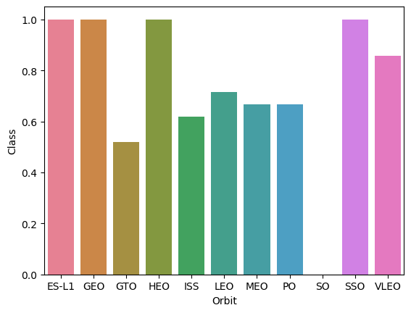
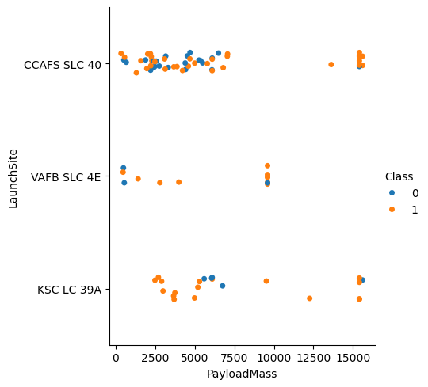
EDA with Data Visualization
In this section, we conducted basic exploration of the data visually. We used Matplotlib and Seaborne to help visualize our information. The following chart types were used:
Code used to preform these functions can be viewed at the following location
https://github.com/Bootscum/IBM-Data-Science-Capstone-Project/blob/main/pt%205%20visualisation%20edadataviz.ipynb
Scatter - Showed Success/Failure of launches based on related features
Bar – Showed Success/Failure of launches based on Orbit
Line – Showed Success/Failure of launches based on year

Slide 12
EDA with SQL
Some of the data exploration was conducted using sqlite3. The following is a non-exhaustive list of queries that were performed:
https://github.com/Bootscum/IBM-Data-Science-Capstone-Project/blob/main/pt%205%20visualisation%20edadataviz.ipynb
Query | Purpose
SELECT DISTINCT Launch_Site FROM SPACEXTABLE | Find all unique launch sites
SELECT SUM(PAYLOAD_MASS__KG_) as 'TOTAL_PAYLOAD_MASS_KG_' FROM SPACEXTABLE | Collect the total lifetime payload sent on this platform
SELECT AVG(PAYLOAD_MASS__KG_) as 'TOTAL_MODULE_MASS' FROM SPACEXTABLE WHERE Booster_Version LIKE 'F9 v1.1%'; | Collect the total lifetime payload sent on the Falcon9 V1.1 booster specifically
SELECT MIN(Date) FROM SPACEXTABLE WHERE Landing_Outcome == 'Success' | Find the earliest success of this system
SELECT Booster_Version FROM SPACEXTABLE WHERE PAYLOAD_MASS__KG_ = (SELECT MAX(PAYLOAD_MASS__KG_) FROM SPACEXTABLE) | Find the successful launches with the largest payloads
SELECT Landing_Outcome, COUNT(*) AS 'Total' FROM SPACEXTABLE GROUP BY Landing_Outcome ORDER BY 'Total' DESC; | Rank the count of landing outcomes (such as Failure (drone ship) or Success (ground pad)) between the date 2010-06-04 and 2017-03-20, in descending order

Slide 13
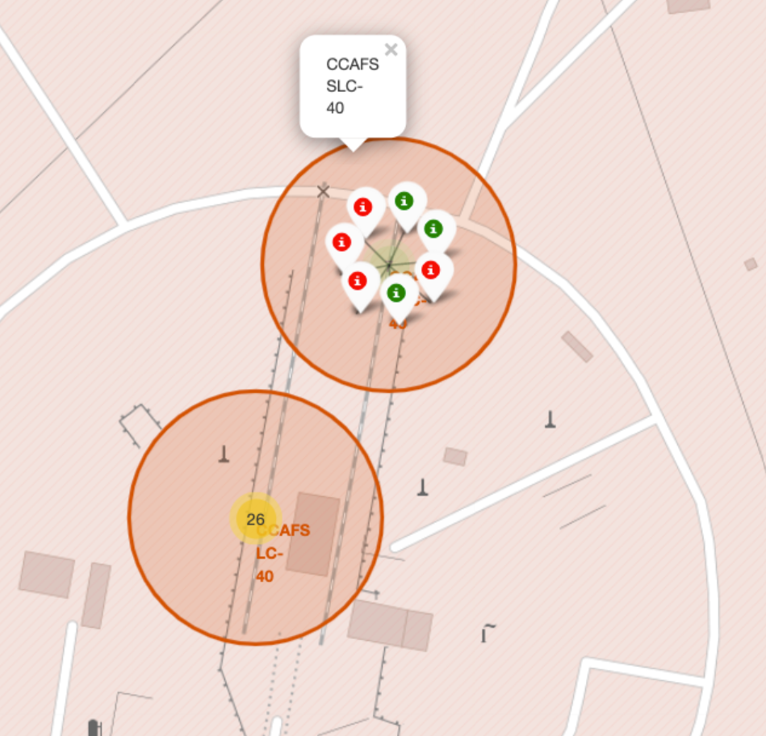


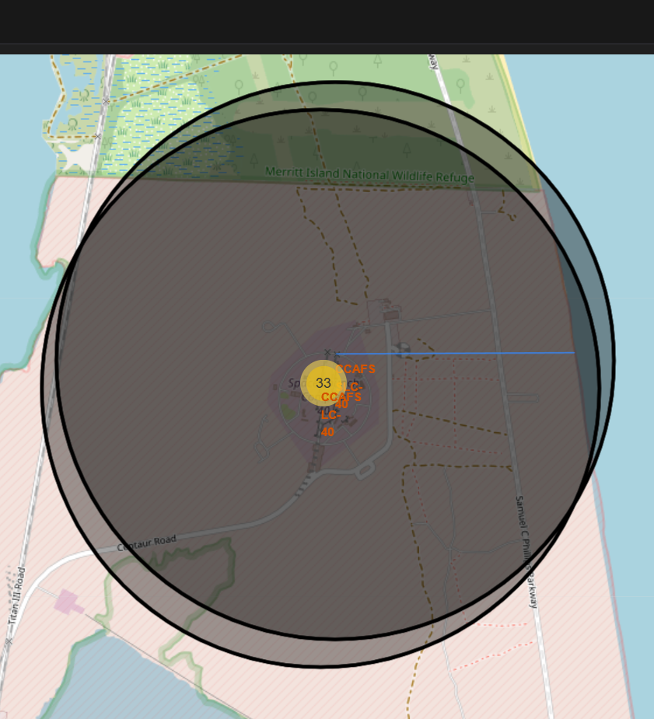


Build an Interactive Map with Folium
Folium was used to gather Geographical Data and apply markers to the map, such as:
Lines – showing distances to relevant geographical features(i.e. Highways, coasts, railways, etc.),
Pop-ups – showing information regarding the launch itself
Circles – showing clusters of markers
Markers – showing individual launch sites
https://github.com/Bootscum/IBM-Data-Science-Capstone-Project/blob/main/pt%206%20folium%20lab_jupyter_launch_site_location.ipynb

Slide 14
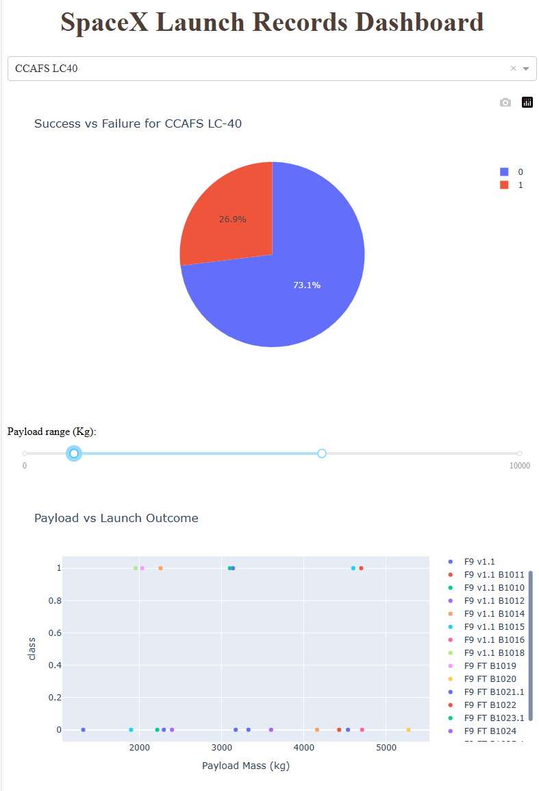
Build a Dashboard with Plotly Dash
An interactive Dashboard was built using Plotly. In this dashboard you can see scatter charts showing success and failure instances for any given booster, as well as a pie chart showing success and failure rates as percentages for any given booster
These interactions help visually identify which boosters have the highest success rates.
https://github.com/Bootscum/IBM-Data-Science-Capstone-Project/blob/main/spacex-dash-app-finished.py

Slide 15
Predictive Analysis (Classification)
Data was standardized, transformed, and fit to an X and Y. It was then split into testing and training sets at a ratio 1/5 and given a random state of 2. A GridSearchCV was then created and iteratively fit with different classifiers to determine the strongest candidate for modeling.
https://github.com/Bootscum/IBM-Data-Science-Capstone-Project/blob/main/SpaceX_Machine%20Learning%20Prediction_Part_5.ipynb
Standardized Data
Split Data
GridSearchCV(GS)
Logrithmic Regression
GS
SVM
GS
Decision Tree
GS
KNN

Slide 16
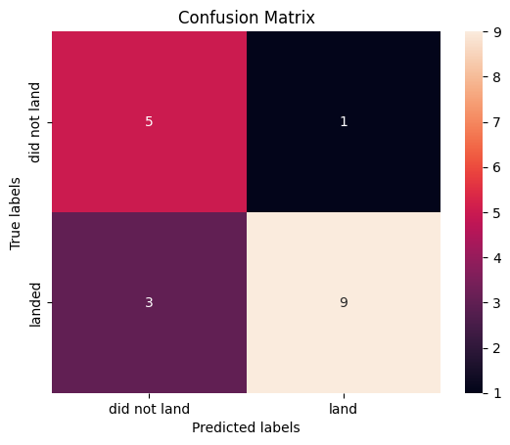
Results
Exploratory data analysis results
100% of ES-L1(Lagrange Point), GEO(Circular Geosynchronous), HEO(Highly Elliptical), and SSO(Sun-synchronous) orbits were successful.
The highest number of successful recoveries were on drone ships
From our interactive analysis, we found:
That the ideal location was Launch Stie KSC LC-39A near Melbourne, Florida, with ~77% of launches being successful.
That the ideal payload is between 2000kg and 4000kg.
Predictive analysis results
Using our model, we can predict with 89% accuracy the outcome of our launch.

Slide 17

Section 2

Slide 18
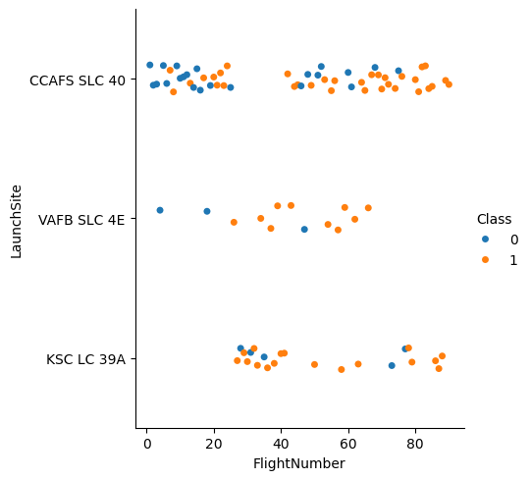
Flight Number vs. Launch Site
A Class of 0 indicates a failure, while a Class of 1 indicates a success.
We can see here that, generally speaking, as more launches are conducted from a given site, their success rate increases.
Additionally, it is apparent that KSC LC-39A has the highest ratio of success

Slide 19
Payload vs. Launch Site
As before, a Class of 0 indicates a failure, while a Class of 1 indicates a success.
While most site can launch a variety of payload weights, KSC LC-39A has a 100% success rate with payloads 2000-4000 kg. While the same is true of VAFB SLC-4E, the sample size is much smaller, and therefore less indicative.
CCAFS SLC-40, by comparison, has a much more mixed rate.

Slide 20
Success Rate vs. Orbit Type
Orbit | Count
ES-L1 | 1
GEO | 1
GTO | 27
HEO | 1
ISS | 21
LEO | 7
MEO | 3
PO | 9
SO | 1
SS) | 5
VLEO | 14
Here we can see that orbit and class have a strong correlation. We can see that ES-L1, GEO, HEO, and SSO have a 100% success rate.
Again, a Class of 0 indicates a failure, while a Class of 1 indicates a success.
Class
Note: GTO is a transitory orbit and therefore not a “True orbit”

Slide 21
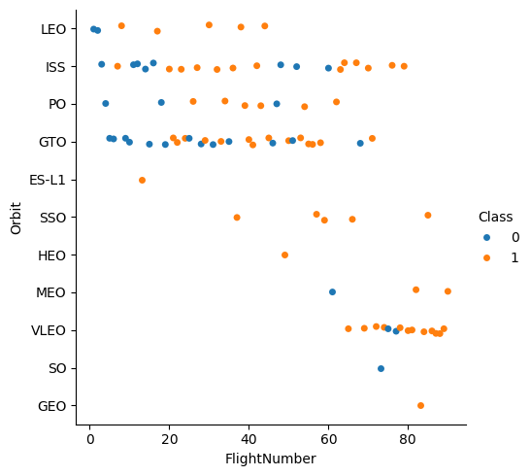
Flight Number vs. Orbit Type
The previous data could prove to be somewhat deceptive unless without some idea of how many launches have been directed towards each orbit. Here, that information is charted for your convenience. It also allows us to see how orbital launches have shifted over time.
Notice that over time Very Low Earth Orbits (VLEO) have become increasingly more common. It is possible this indicates a shift in demand, but that is beyond the scope if this project.
You know the drill, a Class of 0 indicates a failure, while a Class of 1 indicates a success.

Slide 22
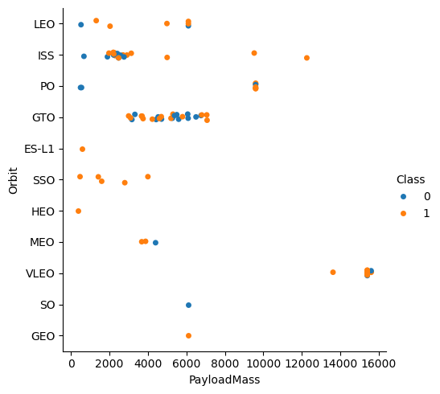
Payload vs. Orbit Type
Here we can see the orbit types matched to the payload mass. We can see our ideal payload range exhibits no failures across the SSO orbit type.
This is the last time I’ll say it, but….
A Class of 0 indicates a failure, while a Class of 1 indicates a success.

Slide 23
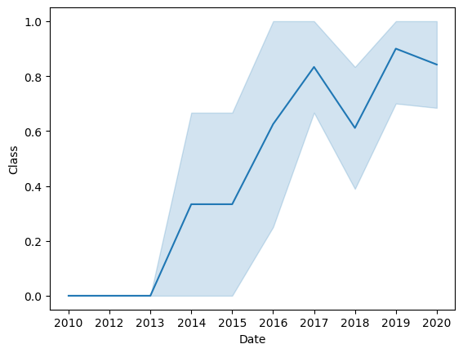
Launch Success Yearly Trend
With any emerging technology, it is key to consider whether there is a track record of improvements in the field to decide whether it’s possibilities have peaked or if there is room for growth.
Here we can see that, except for a dip in 2018, the success of this technology has improved year over year.

Slide 24
All Launch Site Names
Launch Sites
CCAFS LC-40
VAFB SLC-4E
KSC LC-39A
CCAFS SLC-40
Here is a short list of all distinct Launch Sites

Slide 25
Launch Site Names Begin with 'CCA'
These are the first 5 records where launch sites begin with `CCA`. This sample shows some of the types of data utilized.
Date | Time (UTC) | Booster Version | Launch Site | Payload | PAYLOAD MASS(KG) | Orbit | Customer | Mission Outcome | Landing Outcome
2010-06-04 | 18:45:00 | F9 v1.0 B0003 | CCAFS LC-40 | Dragon Spacecraft Qualification Unit | 0 | LEO | SpaceX | Success | Failure (parachute)
2010-12-08 | 15:43:00 | F9 v1.0 B0004 | CCAFS LC-40 | Dragon demo flight C1, two CubeSats, barrel of Brouere cheese | 0 | LEO (ISS) | NASA (COTS) NRO | Success | Failure (parachute)
2012-05-22 | 7:44:00 | F9 v1.0 B0005 | CCAFS LC-40 | Dragon demo flight C2 | 525 | LEO (ISS) | NASA (COTS) | Success | No attempt
2012-10-08 | 0:35:00 | F9 v1.0 B0006 | CCAFS LC-40 | SpaceX CRS-1 | 500 | LEO (ISS) | NASA (CRS) | Success | No attempt
2013-03-01 | 15:10:00 | F9 v1.0 B0007 | CCAFS LC-40 | SpaceX CRS-2 | 677 | LEO (ISS) | NASA (CRS) | Success | No attempt

Slide 26

Total Payload Mass
The Query I used was :
SELECT SUM(PAYLOAD_MASS__KG_) as 'TOTAL_PAYLOAD_MASS_KG_
FROM SPACEXTABLE;
The result was a total of 619967 KG

Slide 27

Average Payload Mass by F9 v1.1
Our chosen booster was F9 v1.1 . A helpful piece of information to know would be what the average mass it can carry is. To that end, using SQLite I ran the following query:
SELECT AVG(PAYLOAD_MASS__KG_) as 'TOTAL_MODULE_MASS' FROM SPACEXTABLE
WHERE Booster_Version LIKE 'F9 v1.1%’;
The result was: 2534.66kg
This provided us with a helpful approximation of what weights to consider.

Slide 28

First Successful Ground Landing Date
Wanting to know more about the history of the technology, our team examined the initial success date and found the first successful landing was 22 December 2015

Slide 29
Successful Drone Ship Landing with Payload between 4000 and 6000
There are 5 boosters that have payloads between 4000 and 6000
Booster_Version | Landing_Outcome | PAYLOAD_MASS__KG_
F9 FT B1022 | Success (drone ship) | 4696
F9 FT B1026 | Success (drone ship) | 4600
F9 FT B1021.2 | Success (drone ship) | 5300
F9 FT B1031.2 | Success (drone ship) | 5200

Slide 30
Total Number of Successful and Failure Mission Outcomes
Below is the count of how many mission For the F9 Booster rocket were successes or failures.
Important to note here is that these are MISSION outcomes and not LANDING outcomes. These do not indicate safe retrieval.
Mission_Outcome | NUMBER
Failure (in flight) | 1
Success | 98
Success | 1
Success (payload status unclear) | 1

Slide 31
Boosters Carried Maximum Payload
Booster_Version
F9 B5 B1048.4
F9 B5 B1049.4
F9 B5 B1051.3
F9 B5 B1056.4
F9 B5 B1048.5
F9 B5 B1051.4
F9 B5 B1049.5
F9 B5 B1060.2
F9 B5 B1058.3
F9 B5 B1051.6
F9 B5 B1060.3
F9 B5 B1049.7
This is a list of the specific Booster models that have carried the maximum Payload

Slide 32
2015 Launch Records
2015 seems like it was generally a poor year for SpaceX with 2/7(28.6%) failed launches
Month | Booster_Version | Launch_Site | Date
01 | F9 v1.1 B1012 | CCAFS LC-40 | 2015-01-10
04 | F9 v1.1 B1015 | CCAFS LC-40 | 2015-04-14

Slide 33
Rank Landing Outcomes Between 2010-06-04 and 2017-03-20
Landing_Outcome | Total
No attempt | 10
Success (drone ship) | 5
Failure (drone ship) | 5
Success (ground pad) | 3
Controlled (ocean) | 3
Uncontrolled (ocean) | 2
Failure (parachute) | 2
Precluded (drone ship) | 1
Between 2010 and 2017, we can see that about 1-in-3 launches made no attempt at recovery. Furthermore, it appears that Parachutes have the highest failure rate as a percentage.

Slide 34

Section 3

Slide 35
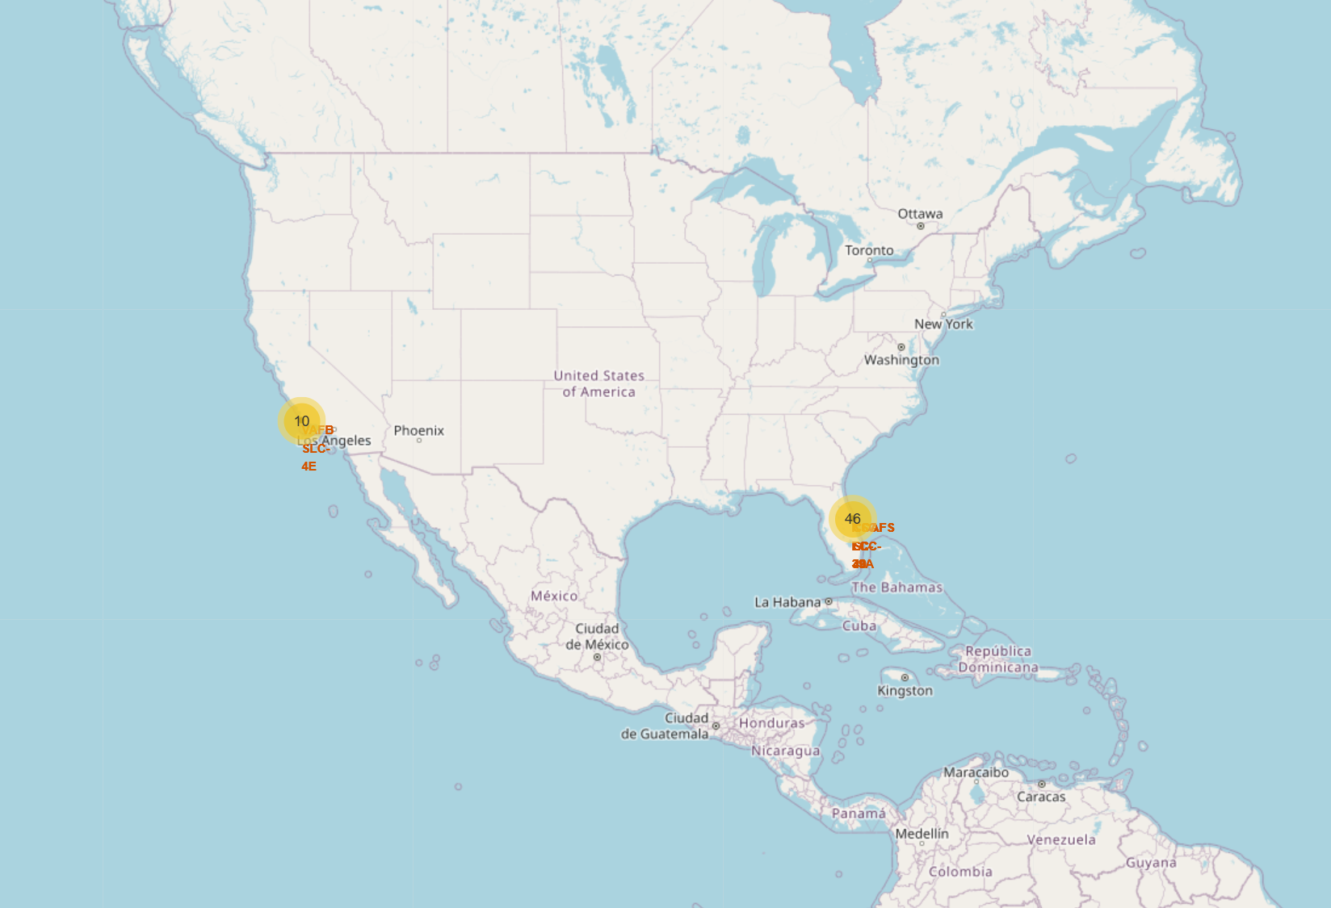
Available Launch Sites
While other launch sites certainly exist, data is available for only a few. I have decided against a global map as most of it would be pointlessly blank.

Slide 36
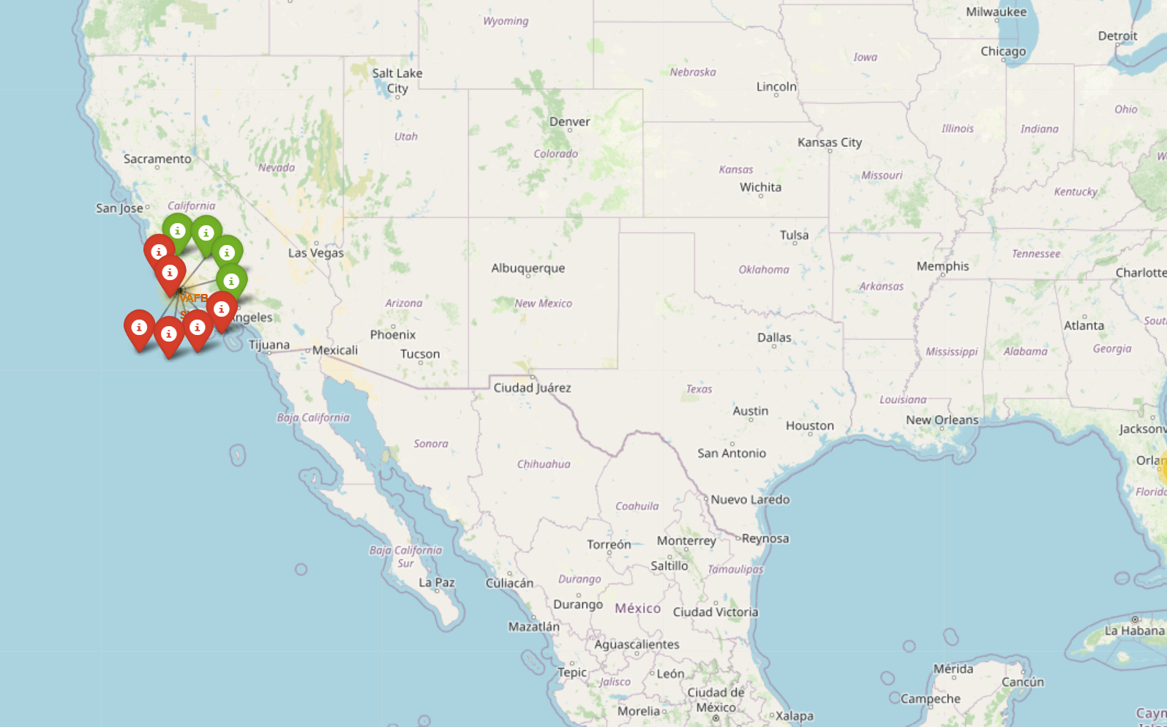
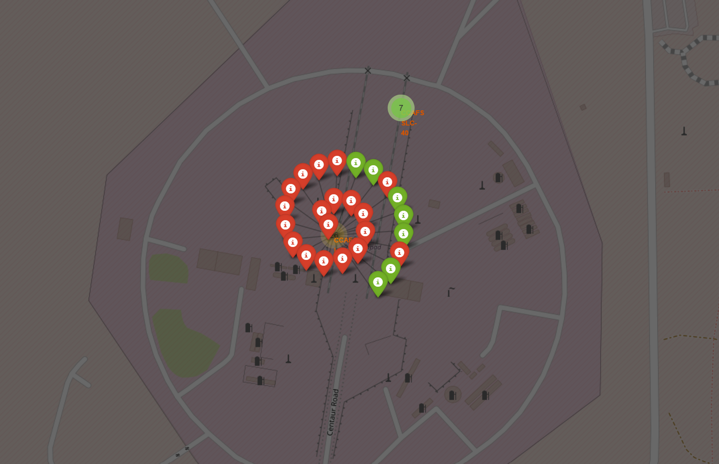
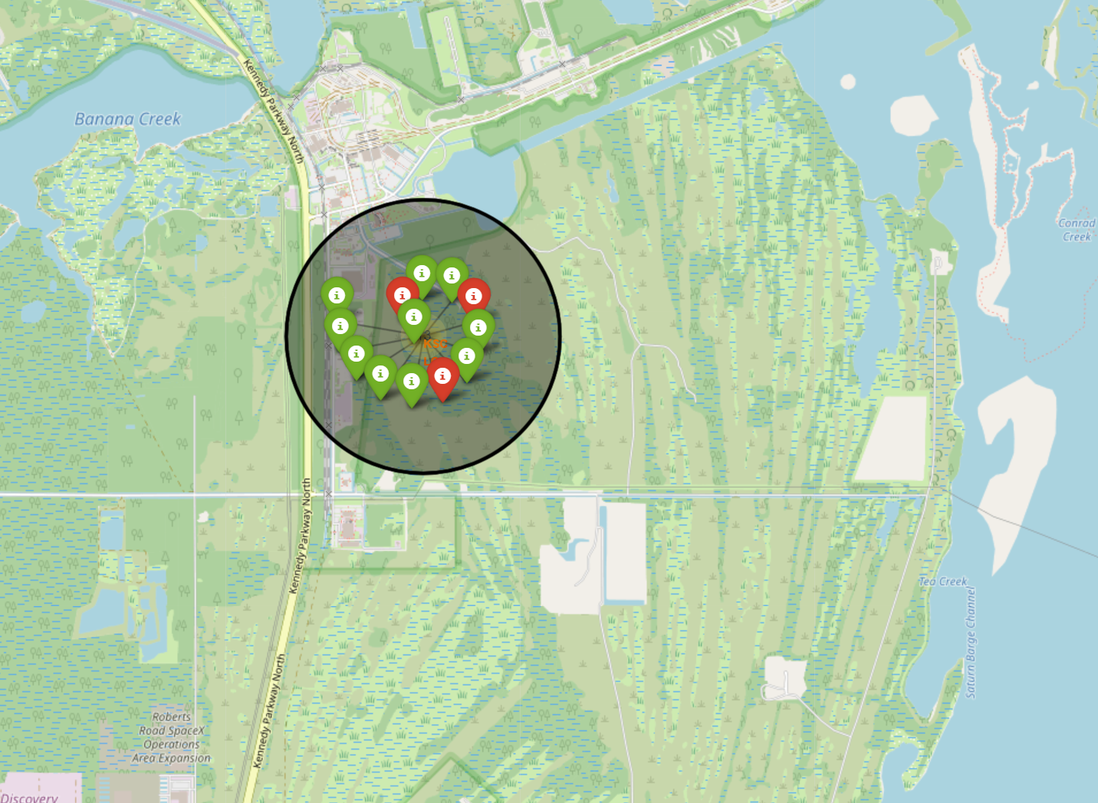
Pop-up Folium Map
Here we can see the outcomes from a variety of sites.
Each of these pop-ups contains helpful information on each launch

Slide 37
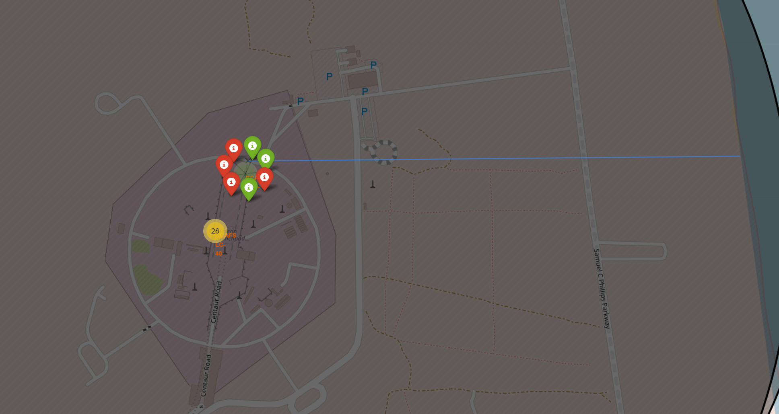
Distance to Coast
This is an example of how we tracked distances between key geographic features.
Each site has its distance
tracked to better understand
better how other features
might impact outcomes.

Slide 38

Section 4

Slide 39
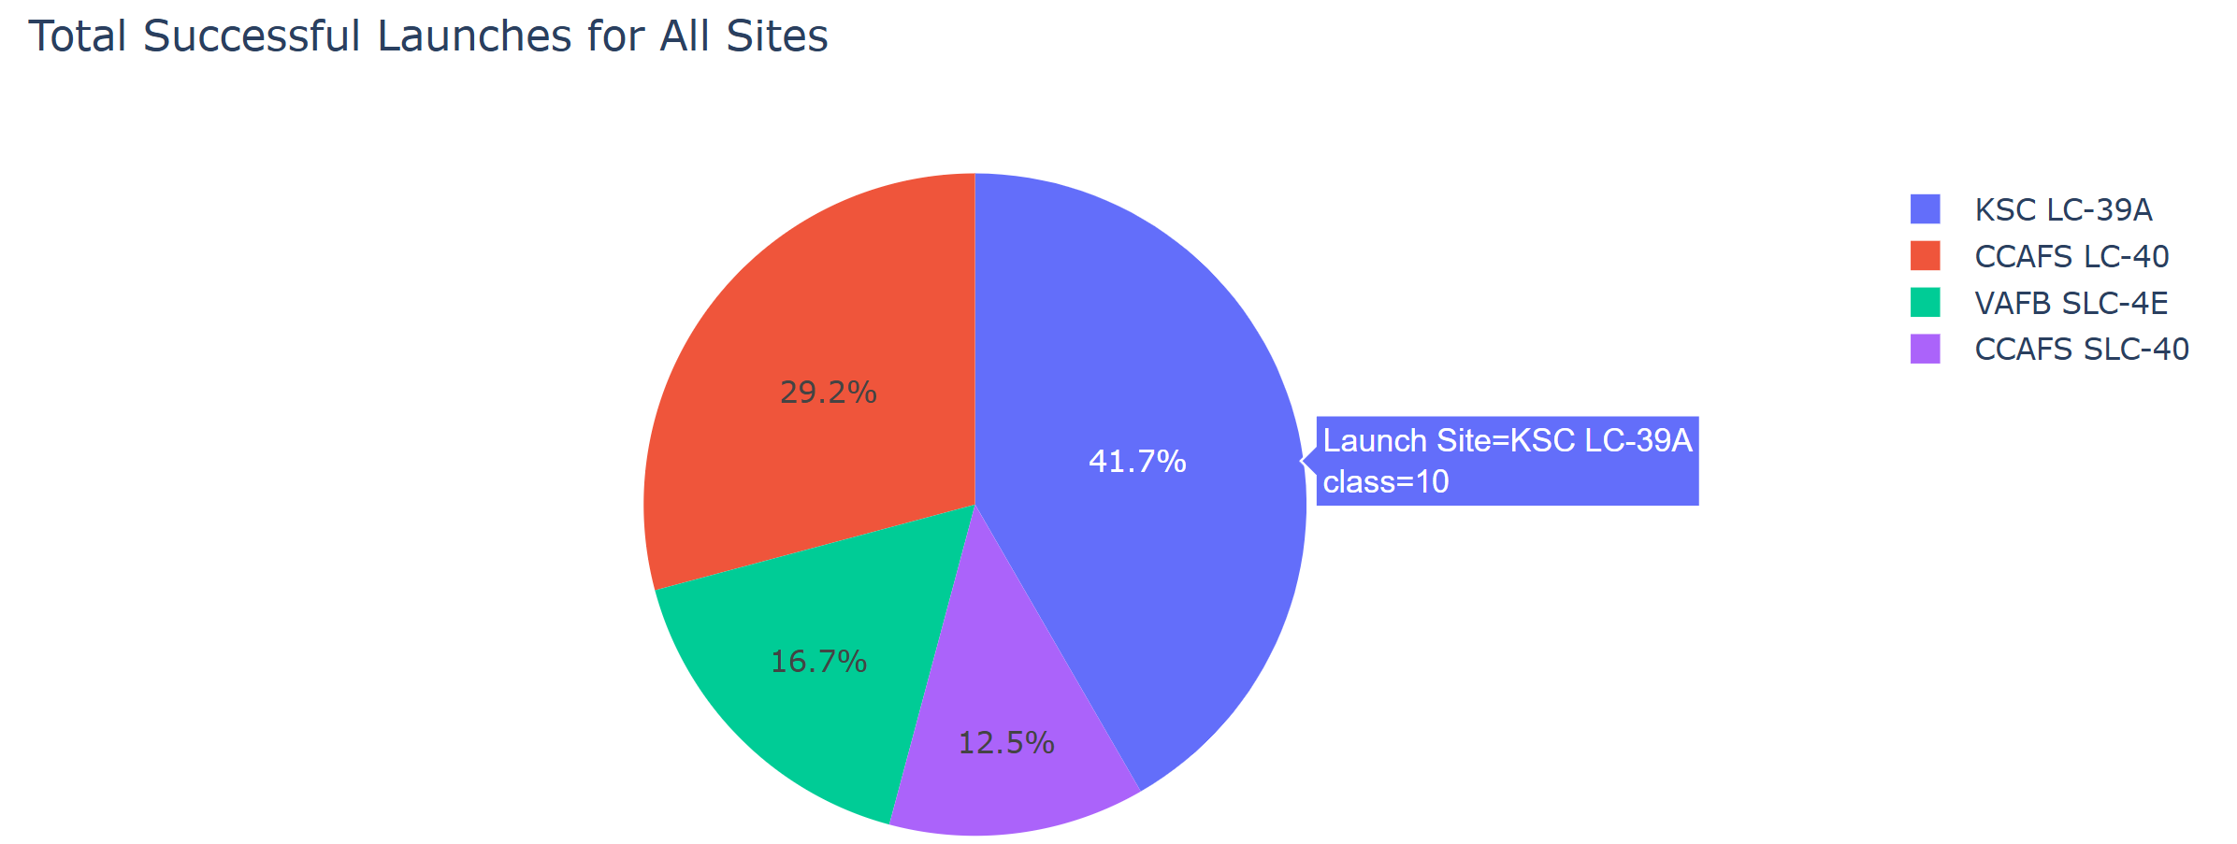
Total Successful Launches for All Sites
This chart shows where successful launches are coming from. From here, we can see that the largest share of successes come from KSC LC-39A

Slide 40
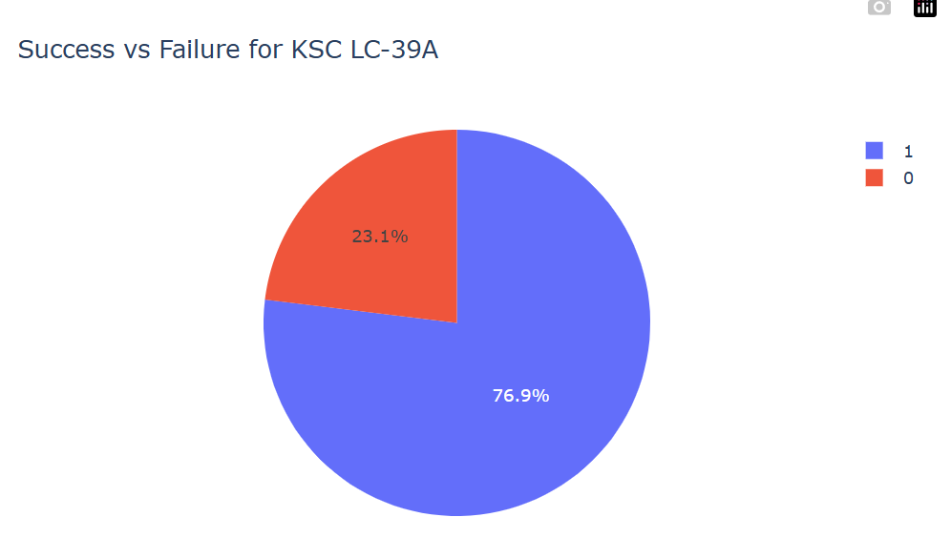
Success and Failure for KSC LC-39A
I know what’re you’re thinking: I said wouldn’t say it anymore, but here I am, saying it. Hopefully this is REALLY the last time, but…. a Class of 0 indicates a failure, while a Class of 1 indicates a success.
We can see an almost 77% success rate at site KSC LC-39A

Slide 41
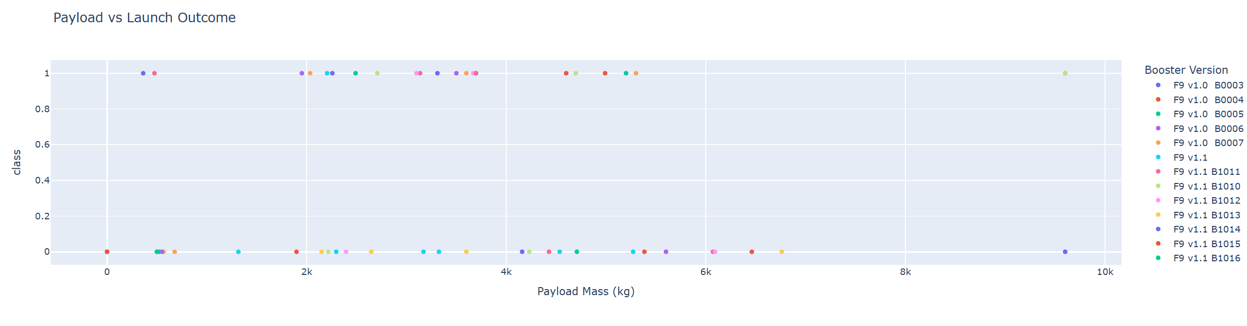
Payload vs. Launch Outcome
The first thing to do is to visualize the graph in terms of bands. The band with the most successes is 2000kg to 6000kg. Narrowing the band down even further takes us to 2000kg to 4000kg

Slide 42

Section 5

Slide 43
Classification Accuracy
This chart shows accuracy as a percentage.
Here we see that the Decision Tree has by far the highest accuracy

Slide 44
Confusion Matrix for Tree Decision
Based on our Confusion Matrix, we can see that there are the fewest False Positives. While there is room for improvement, any thing more accurate could be suspected of overfitting the data

Slide 45
Conclusions
To restate the conclusions:
From our Plotly Visualizations we can see that the optimal weight is between 2k and 4k kg.
Again using our Plotly Dashboard, we see that the site with the most success is KSC LC-39A
From our advance visualization with Seaborne, we can see that there are a variety of good choices for our orbit.
From our initial Data Wrangling, we see that the optimal recovery method is Drone Ship(ASDS)
2k-4k KG
Stie KSC LC-39A
ES-L1, GEO, HEO, SSO
Drone Ship (ASDS)

Slide 46
Appendix
Include any relevant assets like Python code snippets, SQL queries, charts, Notebook outputs, or data sets that you may have created during this project
None at this time (Slide is hidden or at least should be. I don’t know if that will translate when this is exported as a PDF)

Slide 47


